Slide 1
apple pi robotics
9/12/2018

Slide 2
Agenda
  What is FIRST
  Who is Apple Pi Robotics?
  Fall Season
  Registration Paperwork & Youth Protection Program (YPP)
  Build and Competition Season
  Meeting Locations & Logistics
  Costs, Sponsors & FUNdraising
  Expectations and “Gracious Professionalism”

Slide 3
What is first robotics?

Slide 4
What is First Robotics?
  The Mission of First:
  FIRST's mission is to inspire young people to be science and technology leaders, by engaging them in exciting mentor-based programs that build science, engineering and technology skills, that inspire innovation, and that foster well-rounded life capabilities including self-confidence, communication, and leadership.
  FIRST Robotics Video https://youtu.be/31XZ5JsoU9g

Slide 5

The tiers of first

Slide 6
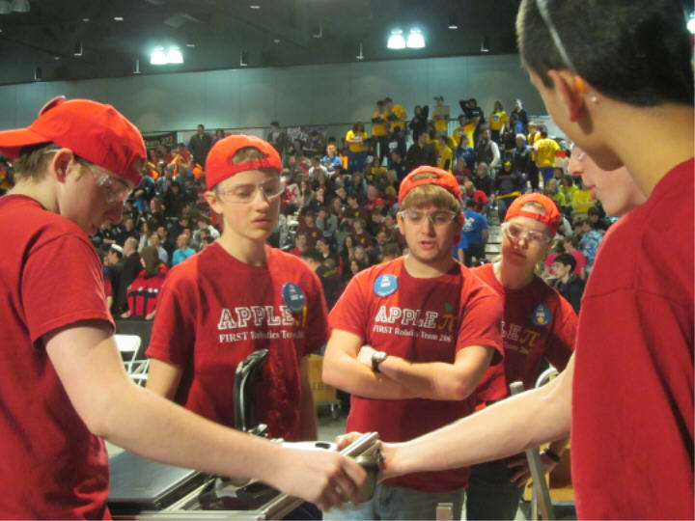
$
Over $80 Million in scholarship opportunities available/200 providers

Slide 7
A brief history of apple pi

Slide 8

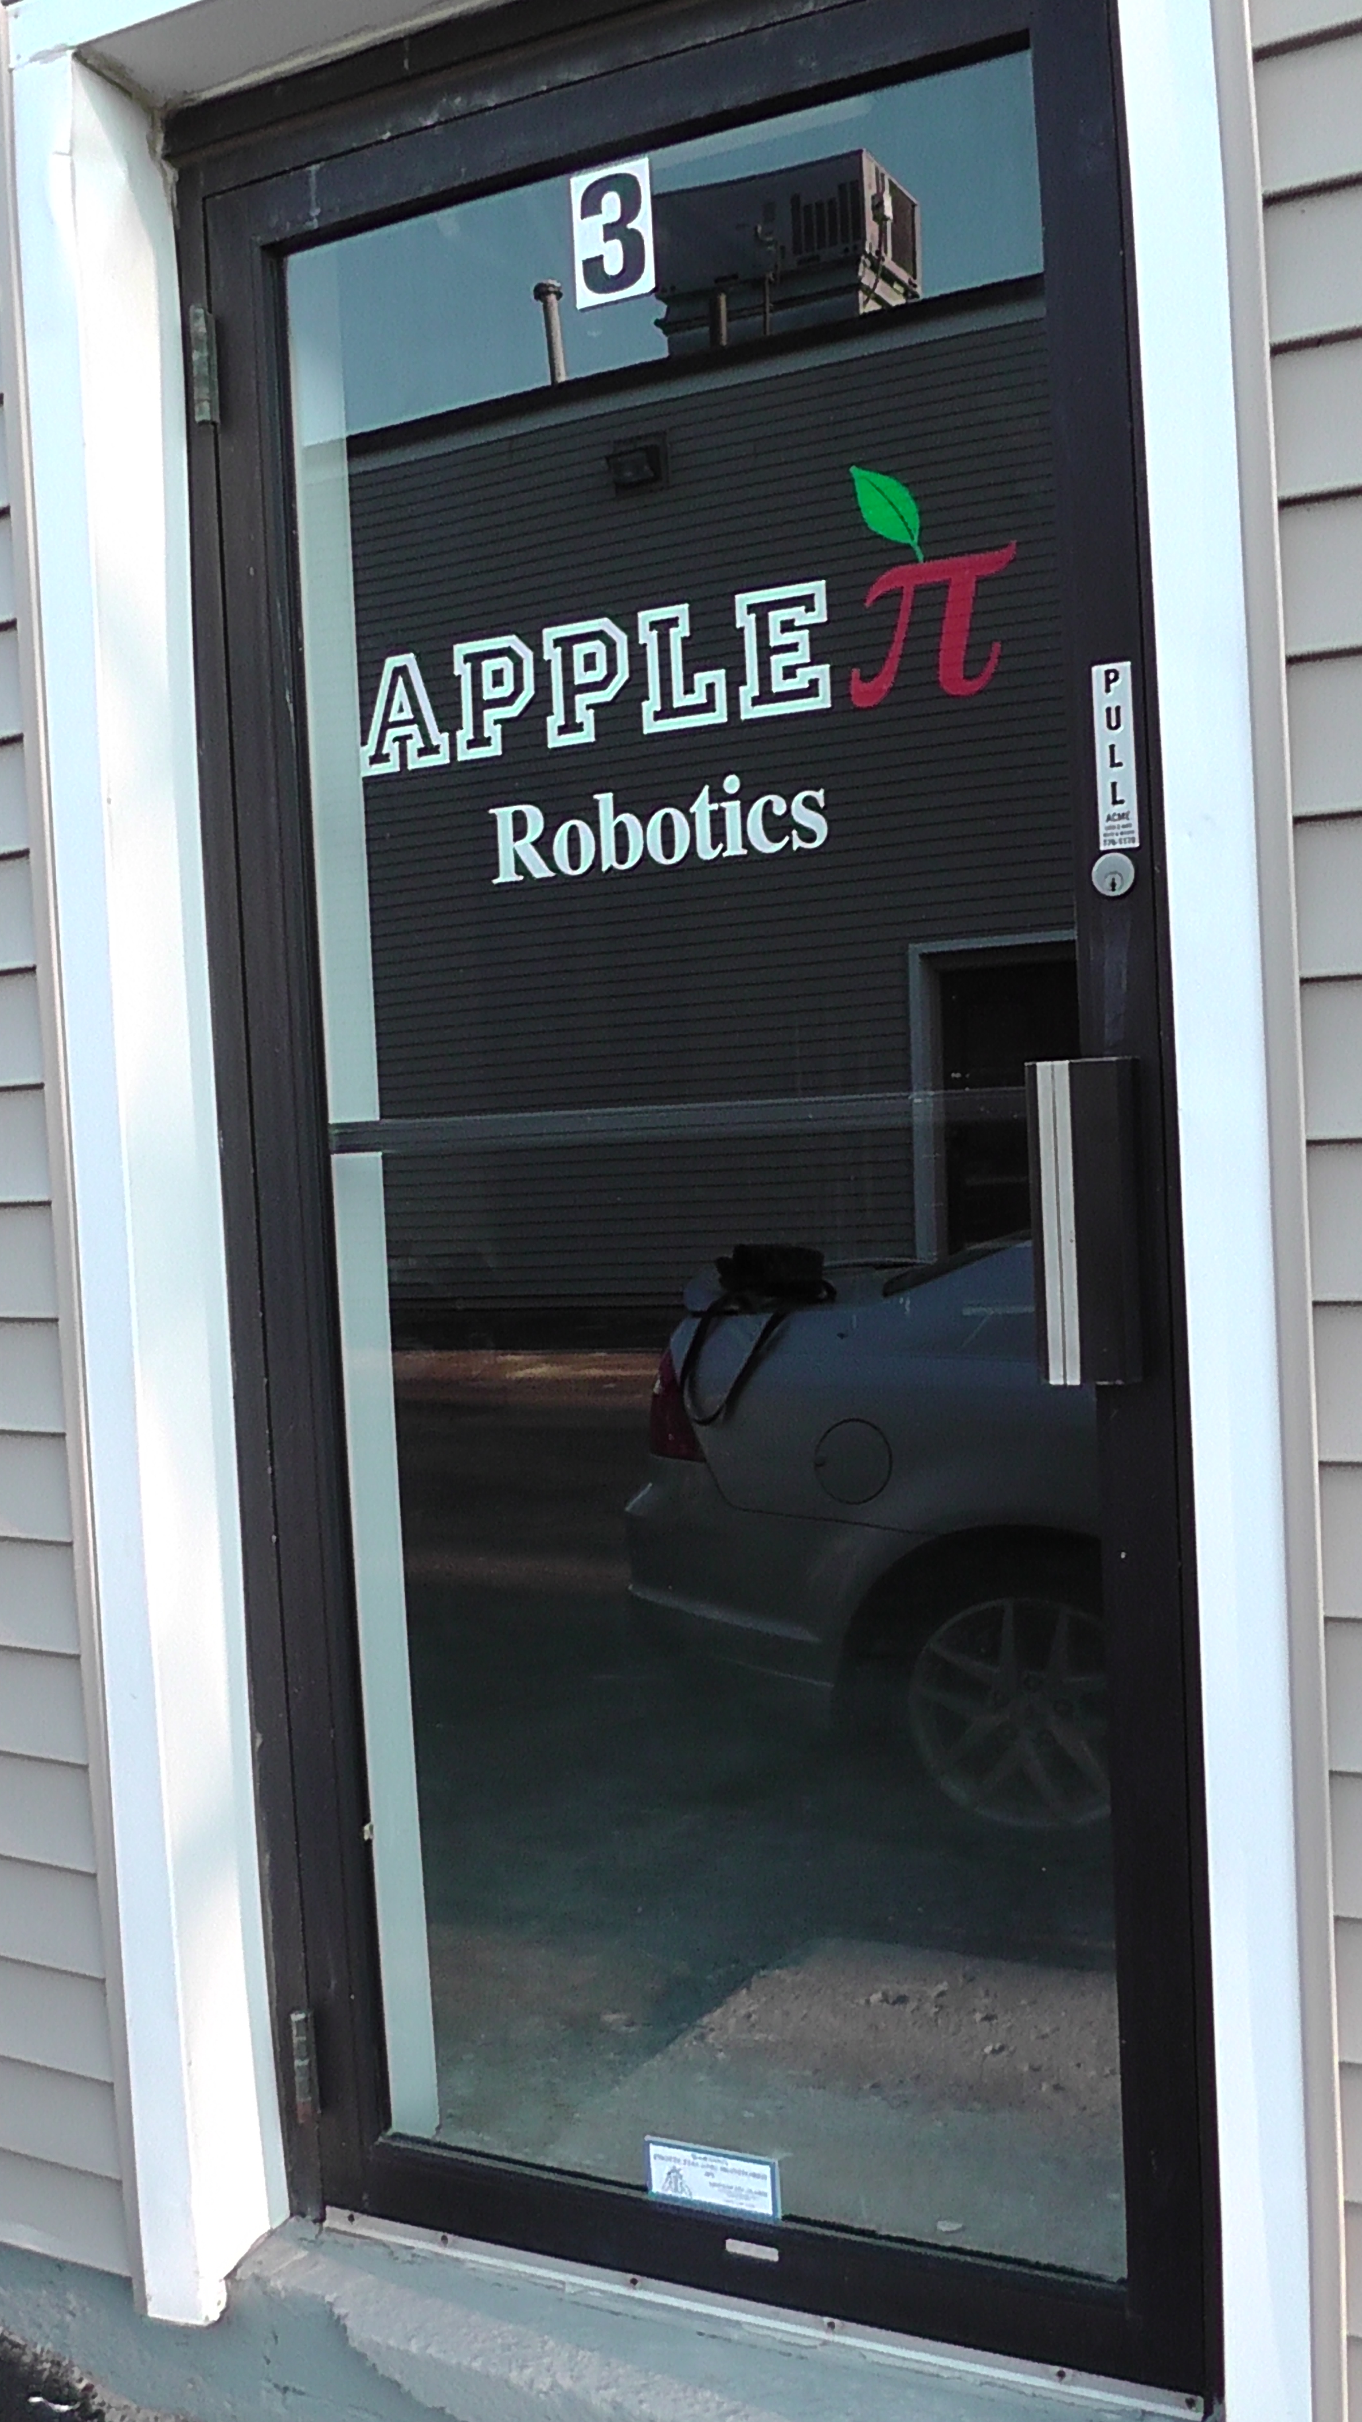
The development of the team
Founded in 2007 by Al Bishop of Bishop's Orchard
Gained support of local businesses and developed key sponsors
Became a 4-H team in 2010
Moved build locations to meet our growing demands -
29 Soundview Rd, Building 2, Unit #3
Continuously grew over the years
  2008: 9 students
  2018: 55+ students

Slide 9
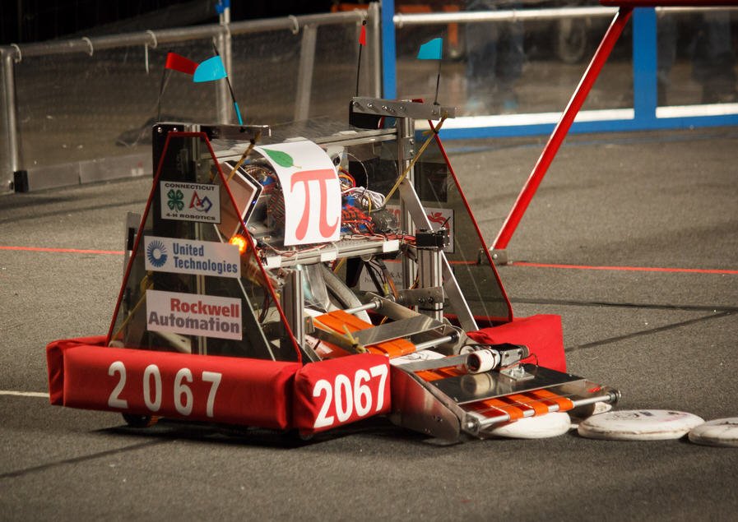
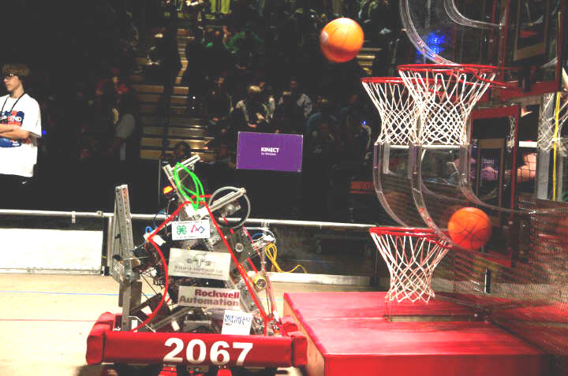
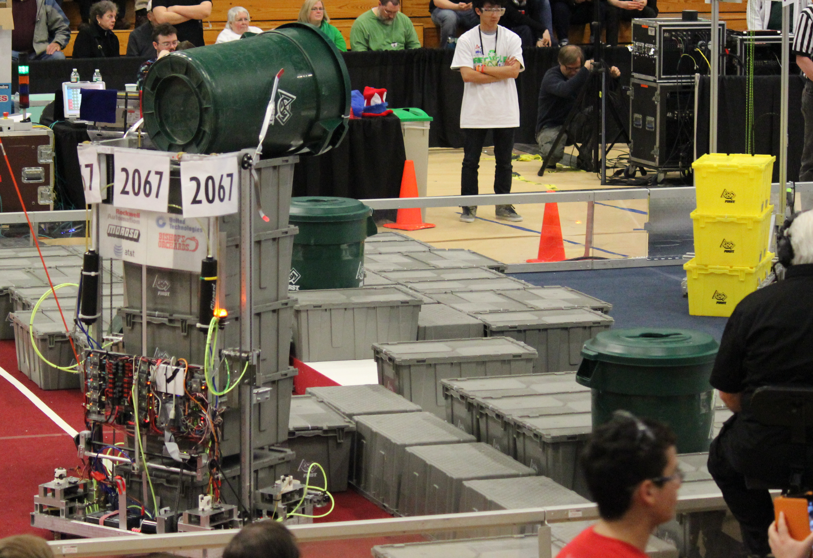
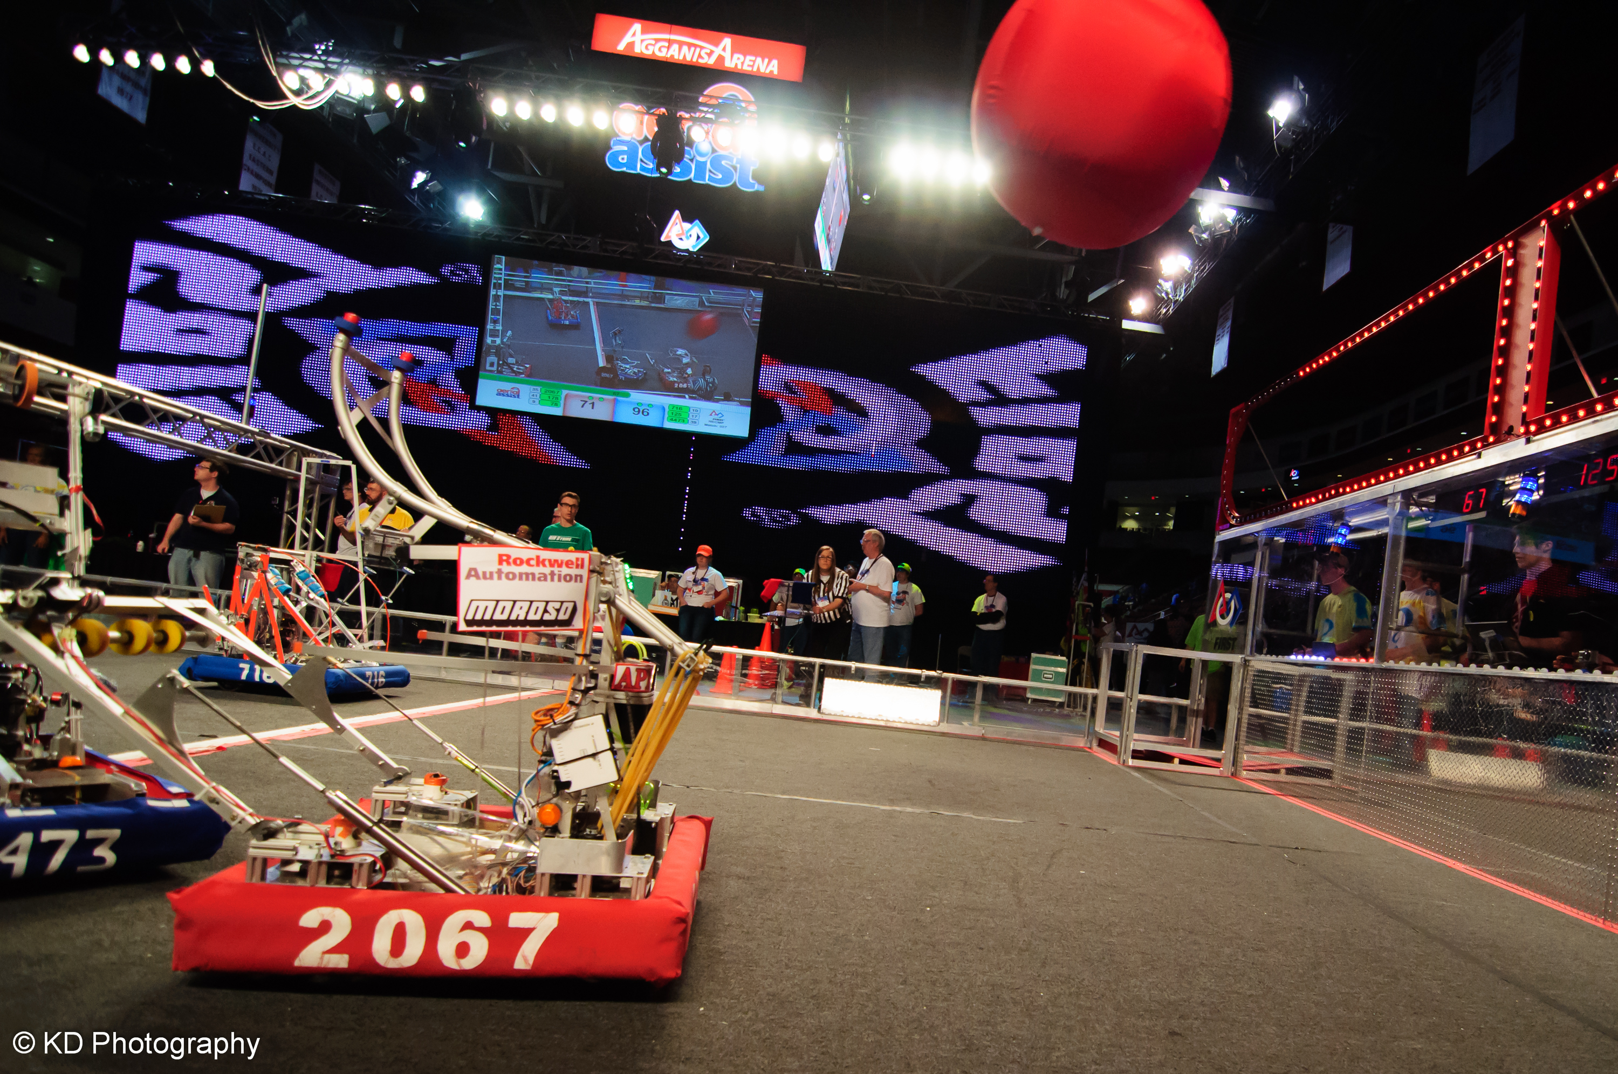
Beginnings of Success 2012-2018
World Championships 6 of 8 years
World Championship bracket quarterfinalist and semi finalist, ranked top 1.5% of teams worldwide (2014 and 2015)
New England District Champions 2015
New England Chairman’s Award Winner 2014
Hartford District Chairman’s Award Winner 2014, 2018
New England Engineering Inspiration Award Winner 2015, 2018
WPI Regional Champion-2012 & Imagery Award Recipient
State Champions 2015
Numbers of finalist/semi finalist competition awards
Grew from 22 – 55 students
First FLL team, now 9 teams
Game Video - https://youtu.be/rYhJflwHLQU

Slide 10
2013
WPI Regional Quarterfinalist
Hartford Regional Finalist
35 students served – FLL & FRC

Slide 11
2014
Groton District Semifinalist
Southington District Semifinalist
Hartford District Chairman’s Award Winner
New England Chairman’s Award Winner
Bracket quarterfinalist, ranked top 1.5% of teams in the world
48 students served – FLL & FRC

Slide 12
2015
Hartford District Finalist
New England Engineering Inspiration Award Winners
New England District Champions
World Championship Field Semifinalists, ranked top 1% of teams in the world
State Champions
Over 70 students – FLL, FTC and FRC

Slide 13
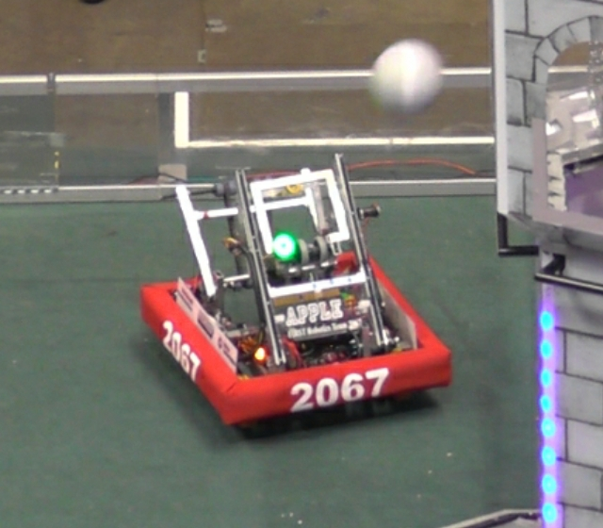
2016
WPI District Quarter Finalist
Rhode Island District Semi Finalist + Rockwell Automation Innovation in Controls Award
Hartford District Quarter Finalist + Engineering Inspiration Award
New England District Quarter Finalist
World Championship Carson Division Quarter Finalist, ranked top 2% of teams in the world
State Champions Quarter Finalist
Over 70 students – FLL and FRC
Game Video https://youtu.be/df6XZppvF3A

Slide 14
The season at a glance

Slide 15
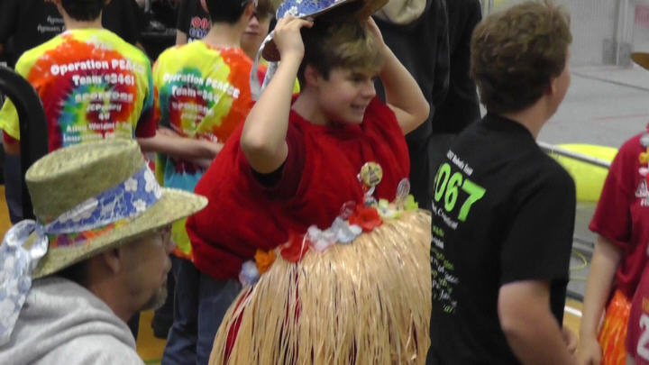
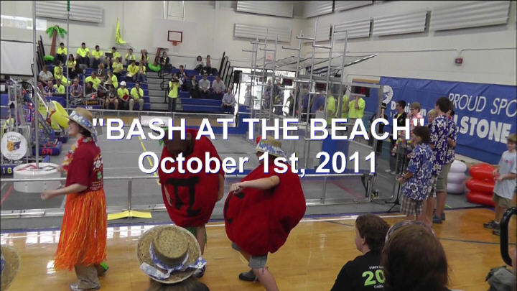
Bash at the beach
All day on Saturday, Oct. 13th at Lyme-Old Lyme HS
Great intro for both parents and students
Likely have a small concession stand - $$

Slide 16
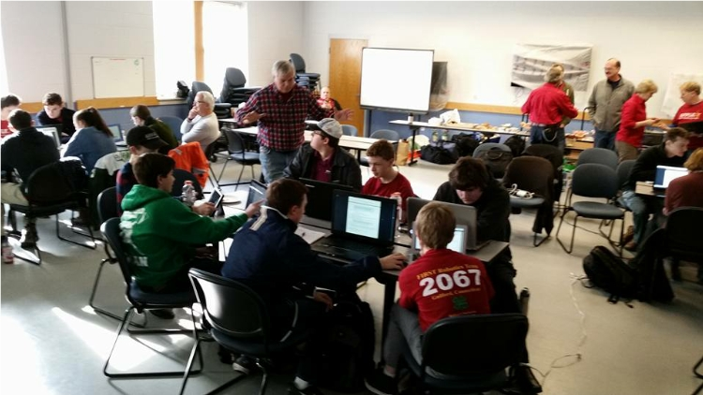
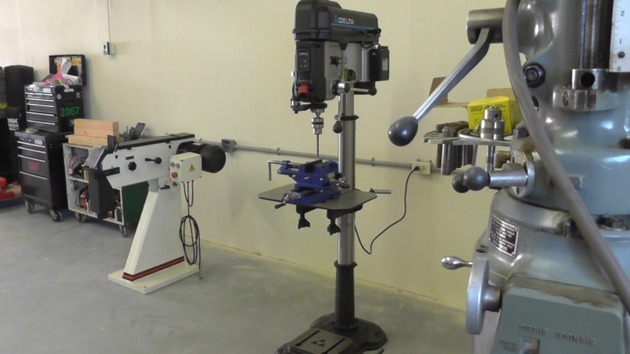
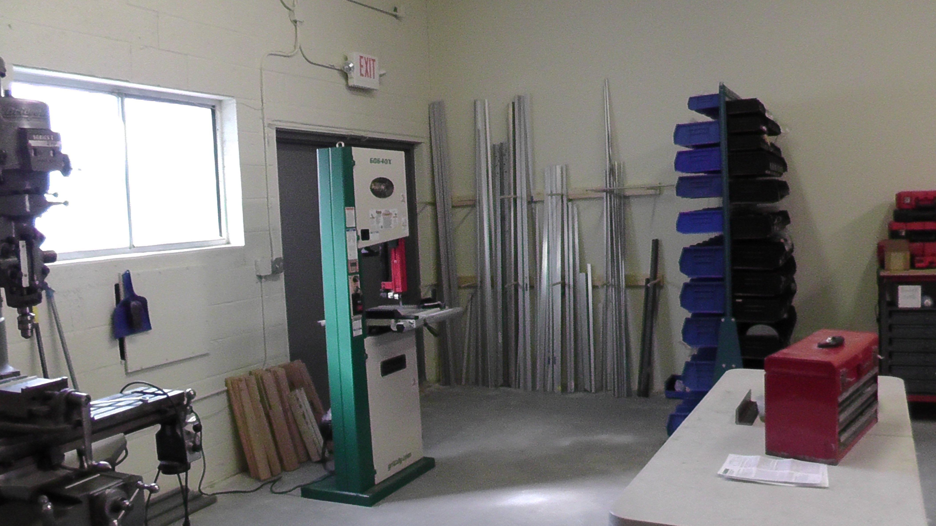
Fall training
Open House at our shop next Tuesday, 9/18
Team building, goal setting and group decision making
CAD and Control System Software Training (Tuesdays & Thursdays)
Machinery at shop; hand tools and power equipment (Wednesday’s)

Slide 17


Fall training
Design/Build (training on mechanical systems – Tues/Weds)
  SolidWorks CAD Design (Tuesdays)
  Basic Mechanics
  Chassis designs, Arm manipulation, Collection system strategies
  Electric and Pneumatic Actuators, power fundamentals
  Shop Machinery Training (hand tools, band saw, drill press, Bpt. Mill, lathe)
Control System & Programming (Thursdays)
  LabView Training (Beginner and Advanced sessions)
  Basic Machine Logic – Logical thinking
  Sensor & Feedback Controls
  Camera/Image Recognition
  Electrical Wiring and Layouts
Participation in fall program is required!

Slide 18
Paperwork, ugh!
4-H Registration
    Available after Oct. 1st www.4Honline.com
    Forms include the 4-H Enrollment , 4-H Health Form and Rules of Conduct
FIRST Forms
    Available at https://my.firstinspires.org/ Go to the “Sign Up” button at the top
    Student registers in Youth Team Member Services. Once student has registered, a parent can log on (using email address provided by student) to fill out consent form
New England Consent/Release Form
    This is a second Consent & Release form for the New England Region (This in addition to the FIRST Robotics Consent & Release form)
    It is a separate section of the FIRST Forms

Slide 19
Youth protection program

Slide 20
FIRST youth protection program
The purpose of the FIRST Youth Protection Program (FIRST YPP) is to provide Coaches, Mentors, Volunteers, employees, others working in FIRST programs, team members, parents, and guardians of team members with information, guidelines, and procedures to create safe environments for everyone participating in FIRST programs.
Put into effect in 2015
    Requires screening for lead mentors
    Requires training for all members who spend significant time with students
4-H background checks required in addition for all mentors
Ypp PDF https://www.firstinspires.org/sites/default/files/uploads/about/FIRST-YPP-ProgramGuide.pdf
YPP Video https://www.youtube.com/watch?v=VPzxm4IfG6w&feature=youtu.be&list=UUyJqS0n0h5f3yeYxEADZuvQ

Slide 21
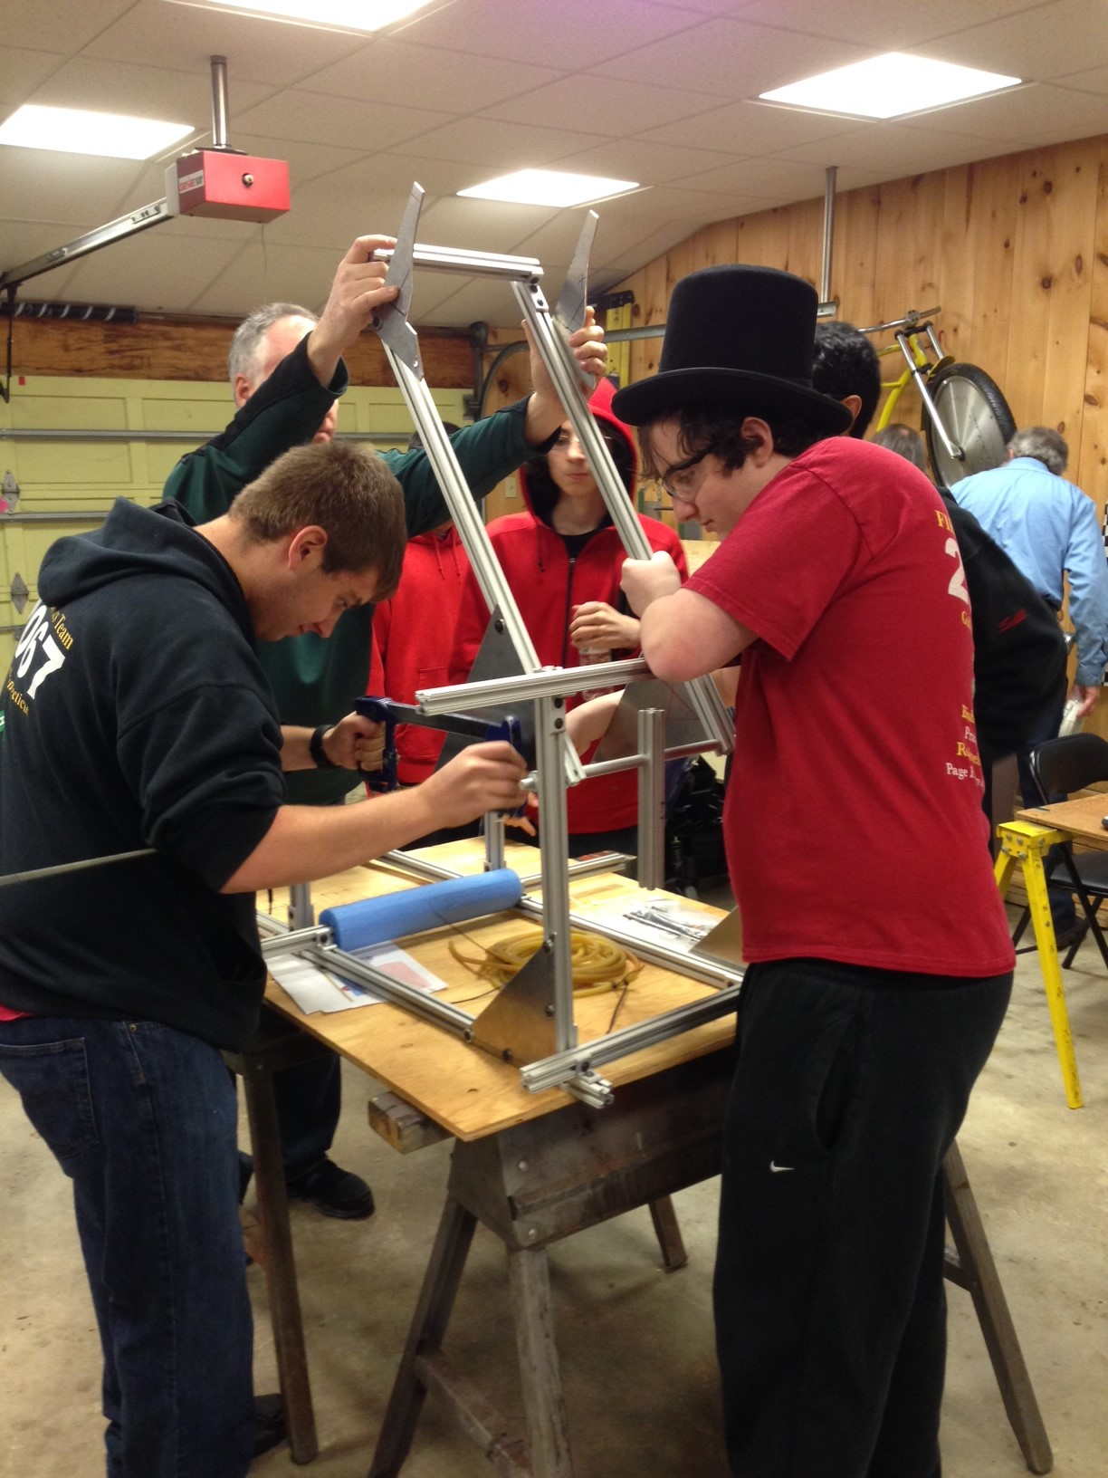
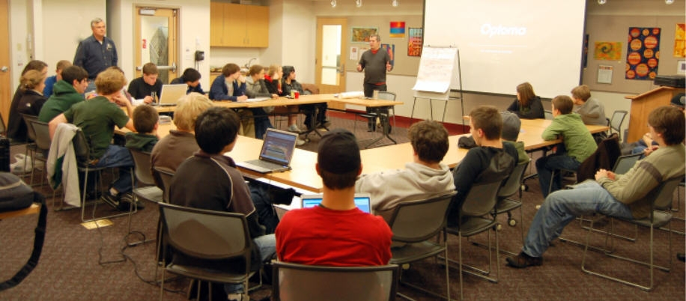
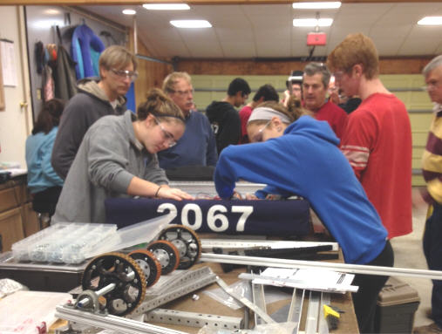
Build season
Six Weeks of Analyzing, Designing, Building, Testing, and Improving

Slide 22
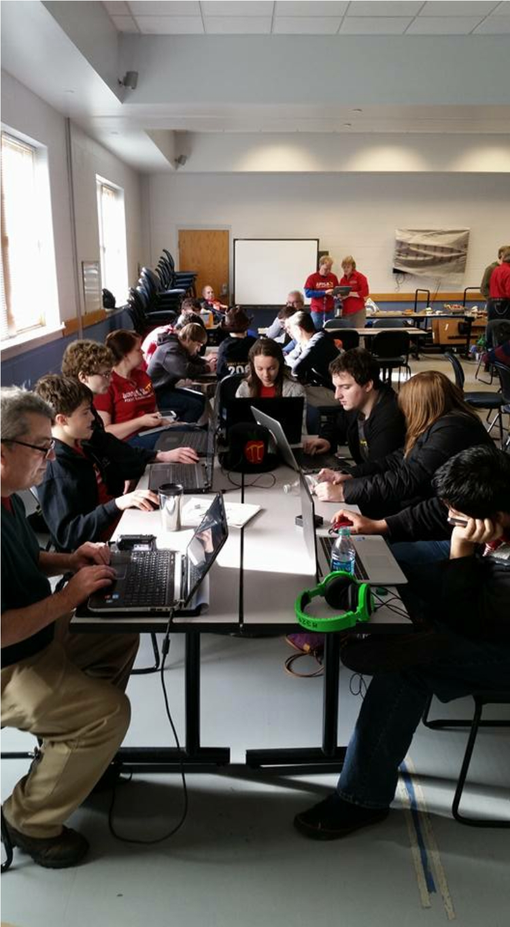
Build season schedule
Jan. 5 – Kick Off – Guilford EMS Building live NASA telecast
    2019 ‘game’ objective and rules are presented
    First weekend spent analyzing game and finding game strategies
    First week spent brainstorming possible designs to satisfy strategies
Robot ships February 19
    There is never enough time!
    We build two robots – Competition and Driver Training/debugging/improvements
Team will divide and conquer
    Large team requires two (2) shifts per day with web based sign-up system
    Team meets 6 times a week during build season
    Each member defines their own schedule – But 2 times/week expected
    Video https://youtu.be/d60FOfoG5fs

Slide 23
competition season schedule
Schedule (Preliminary)
    Suffield Shakedown: February, 16th
    District Event #1 – Waterbury District, CT (March 8-10)
    District Event #2 - Western New England, MA (March 22 - 24)
    District Event #3 – Hartford, CT (April 5 - April 7)
    New England Regional – WPI, MA (April 12-14) IF we qualify
    World Championship - Detroit (April 24-27) IF we qualify
    Connecticut Championships (May)
Off Season
    Where is Wolcott (June)
    Bash at the Beach (October)

Slide 24
Event awards
Competition Awards
  Alliance Winner
  Alliance Runner-up
FIRST Awards
  Chairman's Award
  Creativity, Entrepreneurship, Engineering Inspiration, Excellence in Engineering, Innovation in Control, Team Imagery Award, Industrial Design
District Points
    Points given to winners, runner ups, semi/quarter finalists
    Points given based upon selection order & event ranking
    Points given for all FIRST awards
    Points determine which teams qualify for District Championship and ultimately World Championship

Slide 25
Community

Slide 26
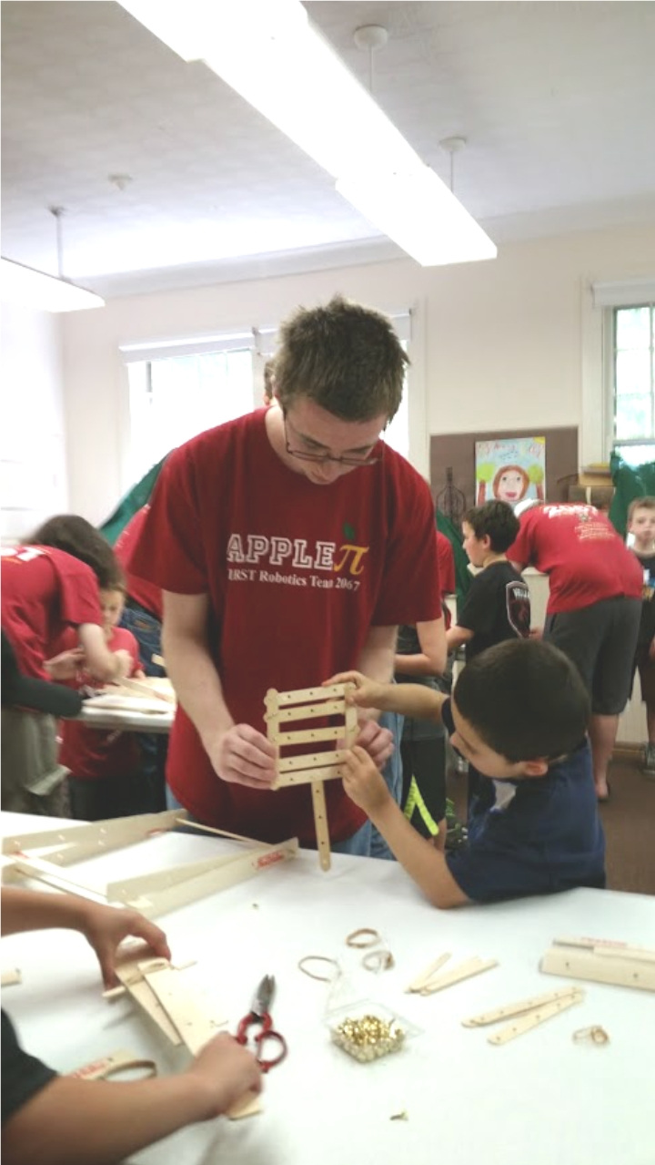
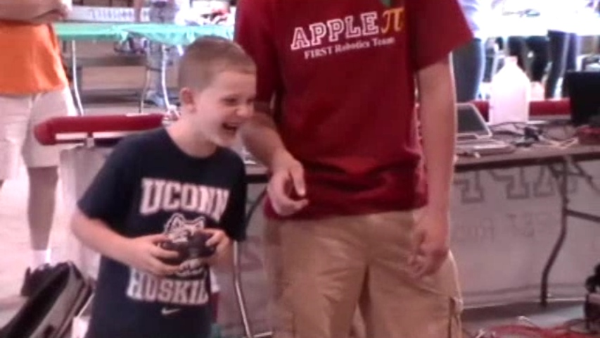
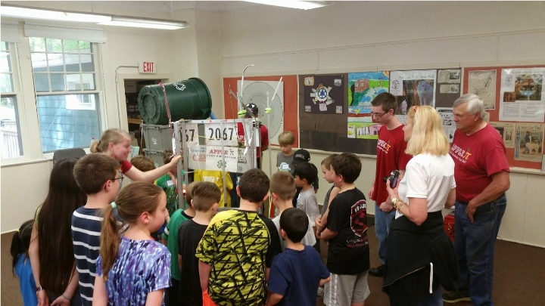
Community outreach
    Student presentations and demonstrations for various groups
        Brownies, Suncatchers, Guilford Library, Shoreline Outdoor Education Center
    Demonstrations at Cruise Nights and “Spooktacular”
    Participation in 4-H Fair, Guilford Fair & Durham Fair
    Tech Tuesdays at the Guilford Library
    Development of FIRST Lego League teams in Guilford and Madison
.

Slide 27
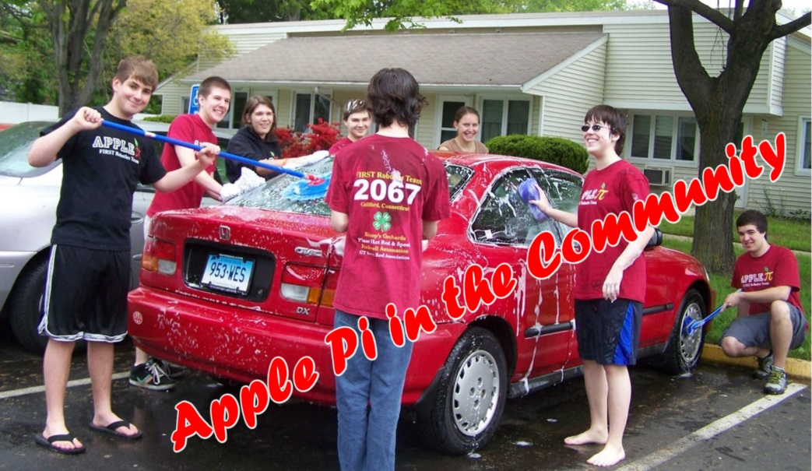
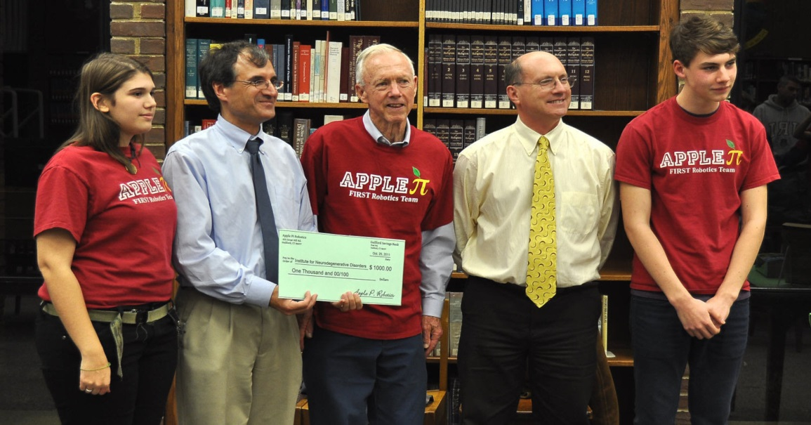
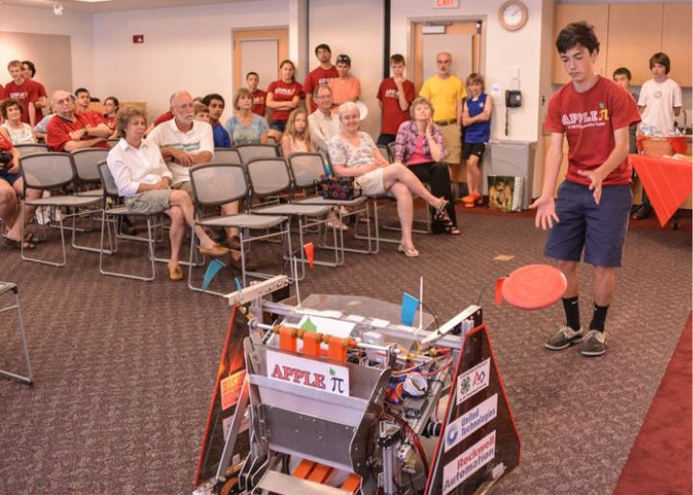
Civic responsibility
    Money raised to benefit Parkinson’s Research
    Car wash & planter construction for “Guilford House” residents
    Coordinated coat drive, board game drive, and book drive
    200 LBS of food collected for the Guilford Food Bank
    Chairman’s Video - https://youtu.be/P2kDmXzct6s
.

Slide 28
Team logistics

Slide 29
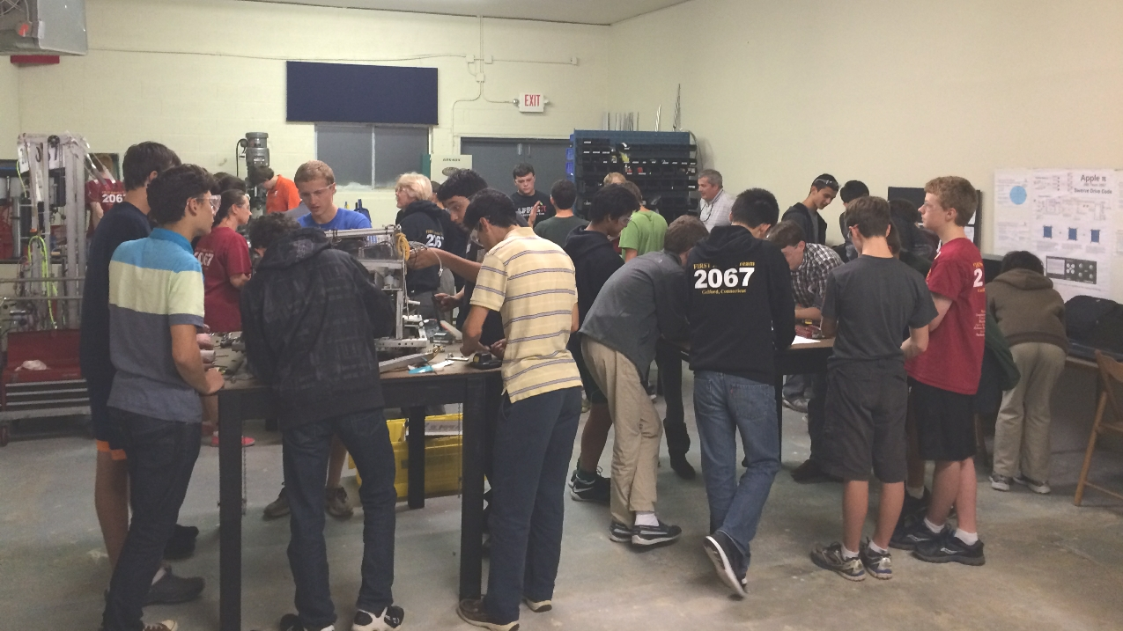
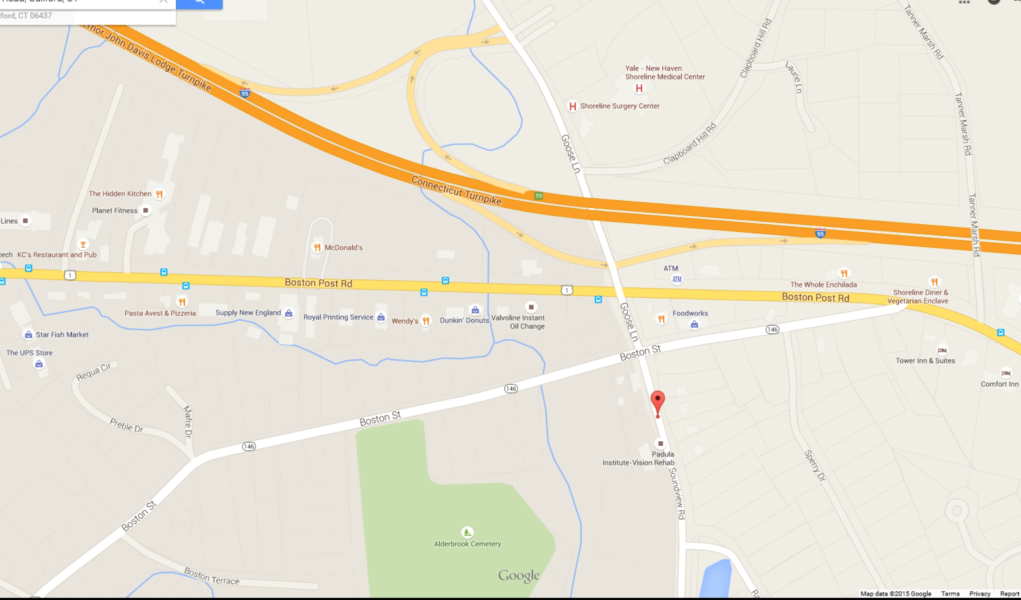
Meeting Locations/times
    Primary Meeting Location
        Workshop – 29 Soundview Road, Building 2, Unit #3, Guilford
    Secondary Meeting Locations
        Guilford Free Library
        Emergency Services Building – behind Police Station, adjacent to Firehouse
        Guilford H.S.
    Meeting Times
        Offseason
            CAD/LabView – Tuesday from 6 to 8 (during fall)
            General meetings - Wednesdays from 6 to 8pm
            Wednesday Fall Training, 2 shifts, times TBD
        Build Season – 2 shifts/day
            Mon-Thurs from 5 to 8:00pm
            Saturday from 9am to 4pm
            Sunday from 11am to 4pm

Slide 30
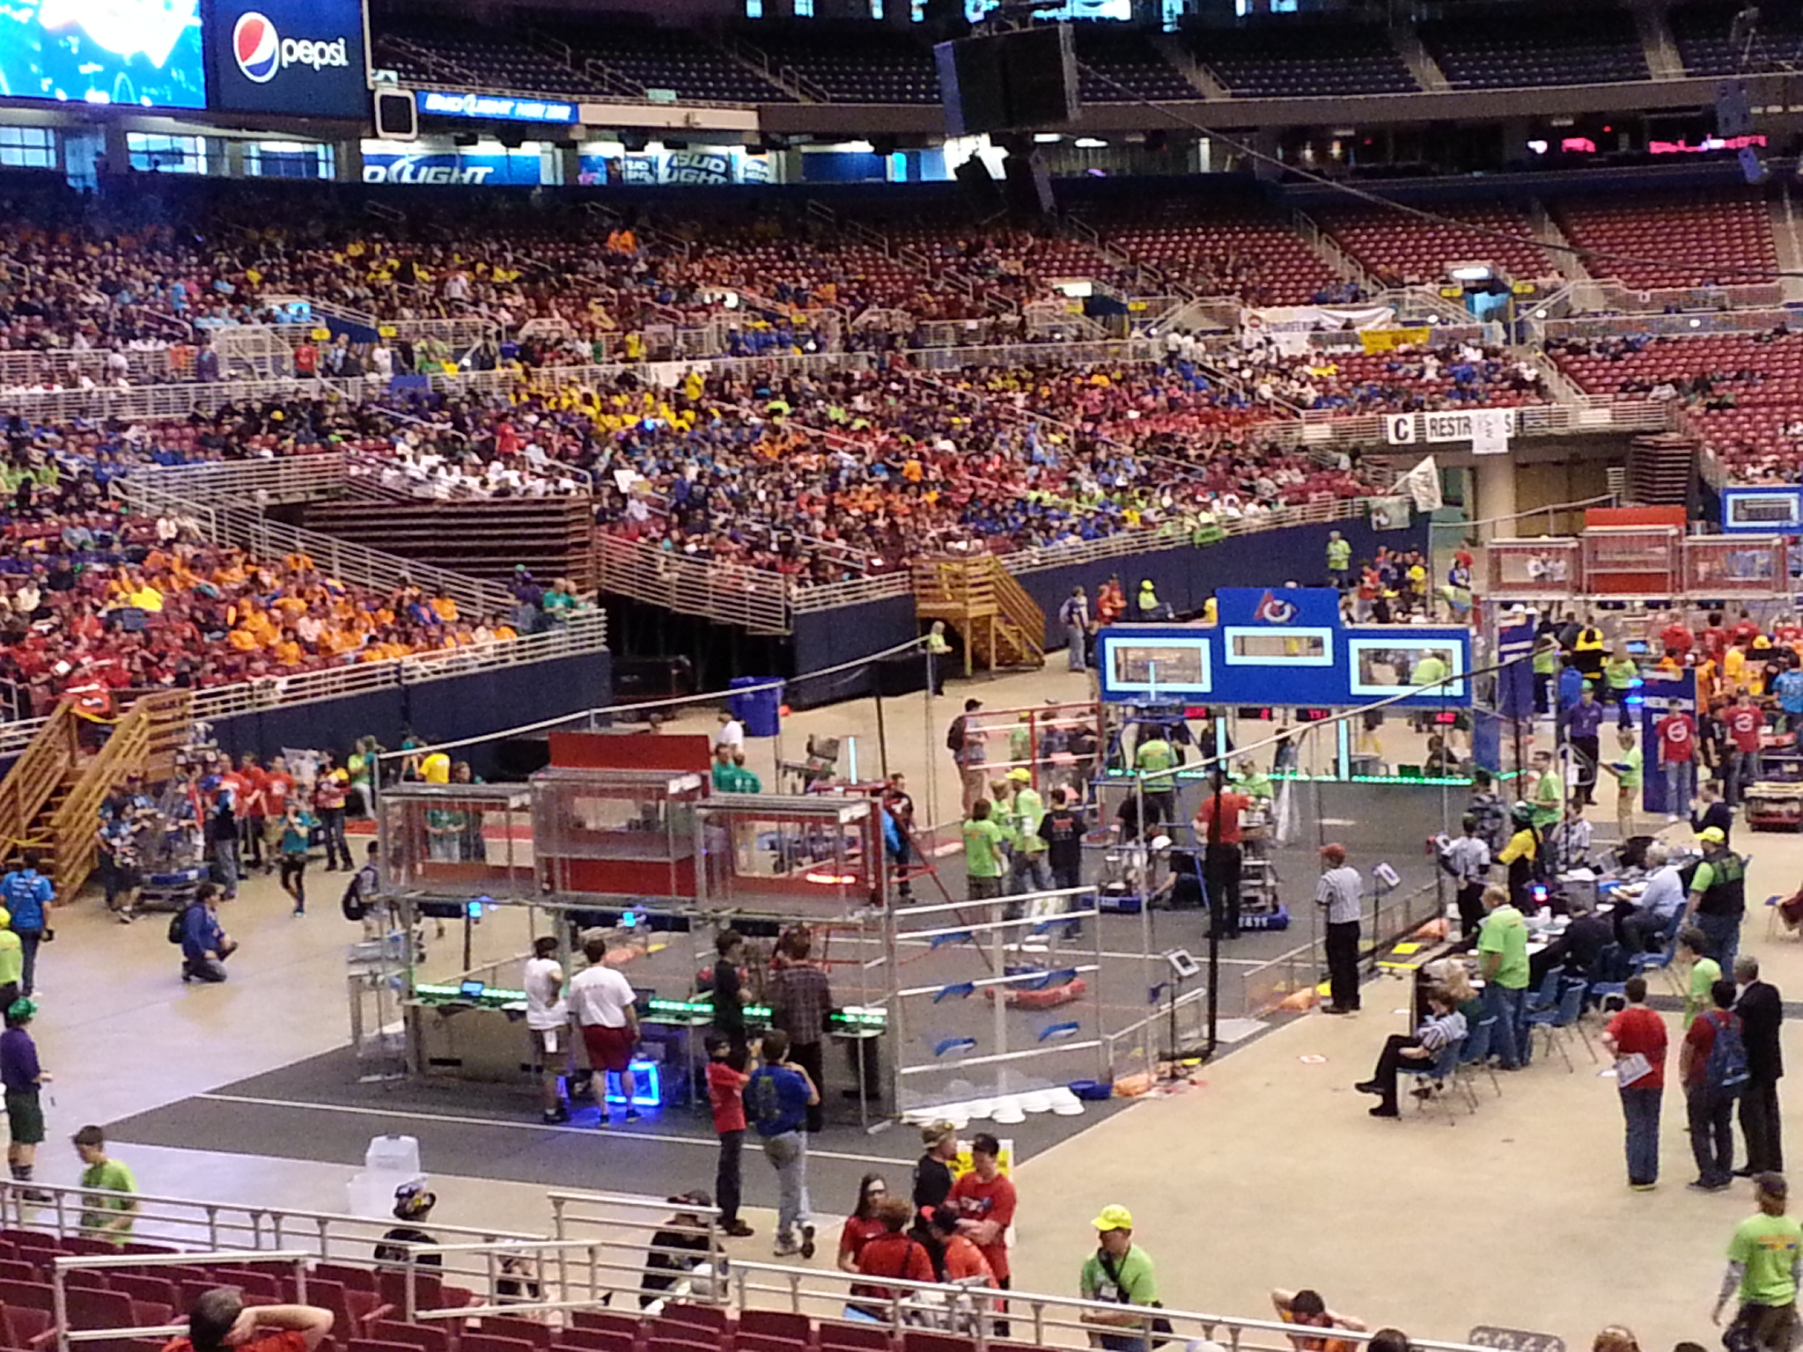
Competition travel & cost logistics
In-state Events
  Carpool each day
  Team covers costs except for food
New England Out of State Events
  Carpool to and from
  Hotel overnights required
  Approx. $100/student
Championship Event (Detroit)
    Air travel
    Hotel for four (4) nights
    Food
    Approx. $750/student

Slide 31
Team Costs and fundraising
Annual Budget of Approximately $40K Not Including Travel
    Bulk costs (75% of budget) covered by sponsors
      Bishop’s Orchard (Founding Sponsor)
      United Technologies
      Rockwell Automation
      Lockheed-Martin/Sikorsky Aircraft
      Intuitive Surgical
      Medtronic/Covidien
      Moroso Performance Products
      Page’s Hardware
      Country Paint & Hardware
    Team fundraising covers remaining 25%
        Cruise Nights - 5 during the summer
        “Spooktacular Cruise In” (Oct. 15th)
        Car Washes
        Member fees

Slide 32
student Costs and fundraising
Special Student Fundraisers (% contributes to student travel costs)
  Selected Car Washes (75%)
  Thanksgiving Pie Sales (100%)
  Student Pursued Cash Sponsorships – Local (50%)

Slide 33
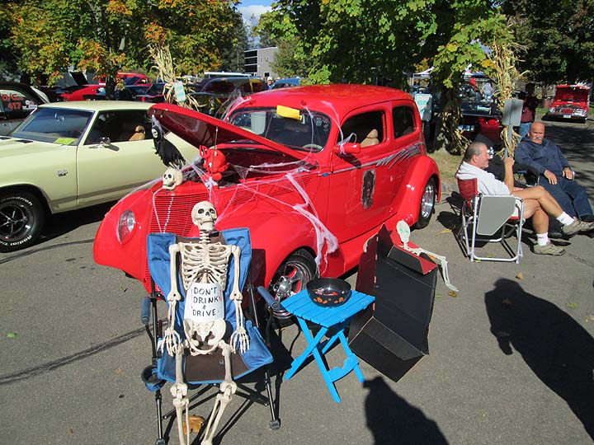
student Costs and fundraising
“SPOOKTACULAR”
    October 20st – (rain date Oct. 21
    Classic Car Cruise In
    Moroso Performance Products
    Cars – BBQ – MUSIC – ROBOTS
    Premier fundraiser - $

Slide 34
communications
Website – www.ApplePiRobotics.org
Classroom (Google) – Student Initiative
Yahoo Group for calendar updates
    Required to have a Yahoo account/email, but not to use
General updates from Juno email – ApplePiRobotics@juno.com (do not reply)
Important emails for contact
    Mentor Emails
        Jim Scott – Capnhook-41@comcast.net General
        Rick Page – rick.page.home@gmail.com General
        Diane VanderGrinten – dvandergrinten@juno.com Financial & Travel Coordination, FLL

Slide 35
Our expectations

Slide 36
expectations
Focus on task at hand when at Apple Pi
Work safely at the shop
Be patient as you learn certain procedures from experienced team members and mentors – often “learning by watching”
Be open to contributing to tasks outside of the robot build process
Meaningful participation – engaged at least twice/week during build season
Regular attendee at training sessions in the fall season

Slide 37
Parent assistance
Parents are welcome to provide expertise and guidance on various subcommittees
Provide assistance with fundraisers
Lend a hand with our transportation needs
Timely drop-offs and pick-ups for team events and shop sessions
Provide assistance with getting all forms and registrations done before deadlines
Occasionally we will ask for nominal donations of snacks, baked goods or other food/beverage items to be used at events

Slide 38
Gracious professionalism
"Competition, not for the sake of destroying one another,
but for the sake of bettering and improving both
competitors as the end result."
https://www.youtube.com/watch?v=PCGsLAyrck4

Slide 39
Next Tuesday
Don’t Forget - Drop in Open House at the Shop
Tuesday, 9/18, 6-8pm
Come see the place your children will spend lots of time at during the season – New Recruits & Parents

Slide 40
Questions?
Apple Pi FUN Video

