Slide 1
Design / Build Basic Steps:
Understand the Game
Game Strategy – How to win at the game
Robot Attributes required to win a game
“Strategic Design”
  Drive train – A good drive train is a must – it allows you to play
  Game-piece manipulator designs – difference maker
    3 subsystems
Prototype, and refine (Repeat as necessary)
  Use of CAD – virtual prototypes can reduce development time
Get done early – and practice, practice! & Refine some more!

Slide 2
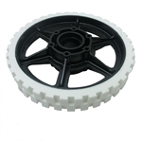
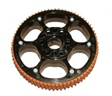
Wheels
KOP – AndyMark Options – 4” @ $6/wheel
KOP HiGrip wheels are good wheels for drive on carpet
  AM quotes μ = 1.07
  Reasonable on smooth surfaces (reported not tested)
Traction tread wheels
  Possibly invented by the Techno-nuts (team 155 Berlin CT)
  Conveyor tread improves friction coefficient to ~ 1.1or more
    Good also on smooth (test data?)
  Conveyor tread is replaceable (riveted on)
  Conveyor tread prone to coming off at some point
  Variants sold by AM & VexPro
    Use blue nitrile conveyor tread (from McMaster)
      http://www.mcmaster.com/#standard-conveyor-belts/=olycq0
      Good friction, better wear and its blue!

Slide 3
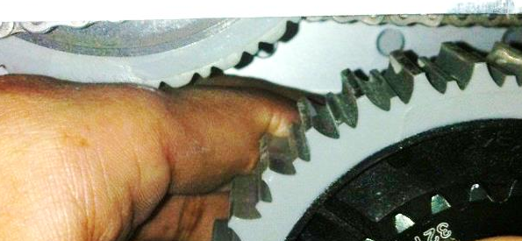
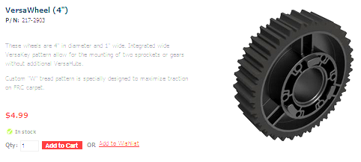
Wheels
Versapro Versa Wheel
  Cheap $5 (vs. $10 one time + $4.33 for tread)
    Need to replace entire wheel when tread is worn
    Wear rate difference= ??
    Need to use all 6 retaining screws – and Locktite or other?
  Good forward traction on rug : mu = 1.3(!?)
    When new – wears pretty quick (1 competition)
    ‘Cleat’ effect on rug
    sideways? or on smooth surface?
    May be questionable on polycarbonate surface (2012 bridge)?
http://www.vexrobotics.com/vexpro/wheels-and-hubs/217-2903.html

Slide 4
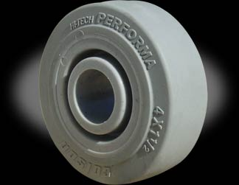
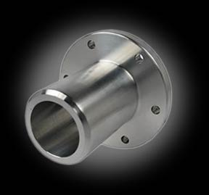
Wheels
Colsons
  Hubs available from WCProducts & RobotMarketplace
    Design by Justin Foss – Team 558 Mentor
    $8 per wheel, $13 per hub
  Good durability to traction
    Never need replacement
  Good traction on smooth surfaces
  Some teams (228) cut grooves for enhanced traction
  Very popular by some top teams
    Locally – 558, 228, 2168 all use them (also many top world teams)

Slide 5
Wheel Trade Matrix
This is a somewhat subjective ranking
  Let’s get some data and make it objective?
    Focus on best options – Roughtop, Versapro, HiGrip KOP, and Colsons friction test
Different games will weight different attributes differently

Slide 6
Wheels
Meccanum
Allows easy implementation of “Holonomic” drive
    Ability to strafe and rotate independently, fun
As seen in recent Star Trek Movies! (forklift scenes)
  https://www.youtube.com/watch?v=vAiwLRGsNrE
Used in 2011 “Logomotion” by Apple Pi
  Allowed easy alignment of tubes to pegs and for minibot deployment
  http://www.applepirobotics.org/media/videos-2/
      Look at ~2:40 & 11:20
Shortcoming is pushing power
  Angled wheels lose 30% of their pushing power
  In 2011 in CT finals we were shut down due to pushing power
  Top national teams have said they put Meccanums on DNP list.
https://www.youtube.com/watch?v=8XkgUBZqWdA
Another view of a basic meccanum

Slide 7
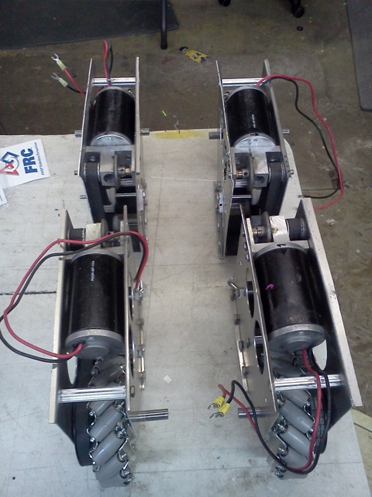
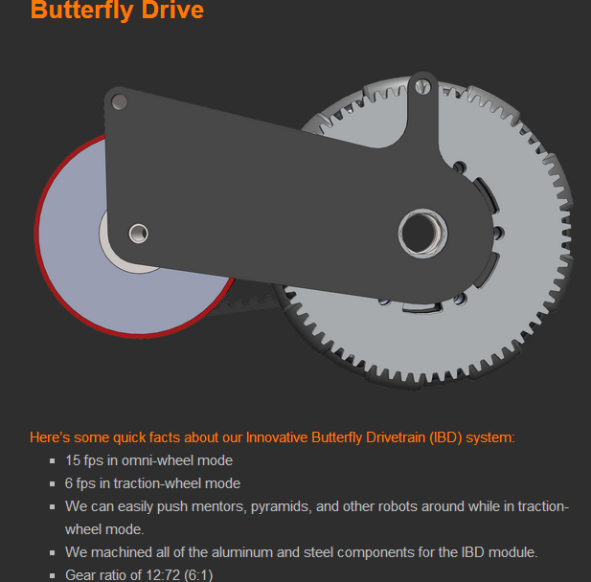
Modular Hybrid drive units
Units can be rotated and then act as tank drive (Octanum)
Hybrid drive actuated typically by pneumatics
Provides maneuverability of Meccanum
With pushing power when needed
Extensive driver training required

Slide 8
Swerve Drive = Crab + Rotation
Unicorn – fully independent drive allows Strafe + Rotation
No skidding when turning and immediate change in direction improves speed and strength
“Superposition” – Vector Addition
+
=
Strafe
“Unicorn” or Fully Independent Swerve
Each wheel to be driven and steered independently,
Also able to turn infinite rotations
8 motors required, requires 4 PID Feedback controls
Rotate
Demo the “Swerve Tester 8” spreadsheet
Make Labview program that reads XYZ Joystick input and sets angle and speed indicators

Slide 9
Swerve Examples
1717:
https://www.youtube.com/watch?v=rVDy4-b_hxo
  Ability to instantly change direction translates to speed
Apple Pi Prototype:
http://www.applepirobotics.org/media/videos-2/
Test it with bumper and weight vs. 2013 tank drive
  at SpookTacular!

Slide 10
Drive Motors (and Transmissions)
For many years CIM motors have been the staple of drive trains
    2, 4, 6 CIM drives (4 most common, 6 was great for 2013, 2 all needed in 2009)
    Generally want all the CIMs you can have on your drive train
    3 CIM allows for full torque single speed (no need for 2 speed?)
    Supershifters (AM) 2 speed gearboxes used 2 of last 4 years, takes lots of driver training – unless automated…..!
    Test opportunity on 2012 robot.

Slide 11
Example Custom Drive Trains

Slide 12
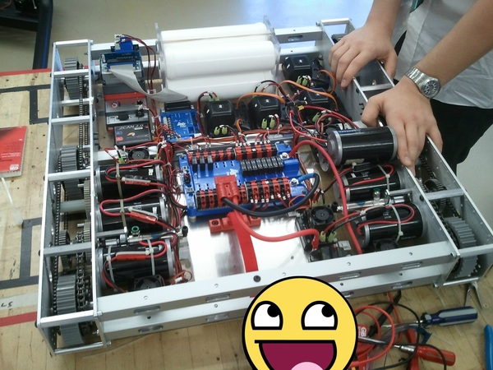
Drivetrains / Chassis
Team 610 (world champs) simple/ custom
6 CIM Drive custom gear train
All CIMS low to maximize low c.g – note battery clamp low and in the middle also.
Frame is all bolted together with spacers.
Threaded rod through 1 in square channels.
Precision machining for custom gear drive
Otherwise simple machining
VersaPro Wheels
Dead Axle set up

Slide 13
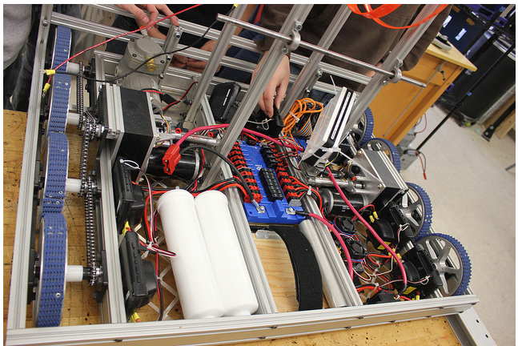
Miss Daisy’s 8 wheel drive – 2012 (Einstein)
80/20 material frame, 6” wheels packed tight for bump
Note also simple COTs components and layout – clean, not difficult
Blue Nitrile Tread from McMaster
Bearing blocks (allow easy chain or belt tightening )
Live Axle Set-up

Slide 14
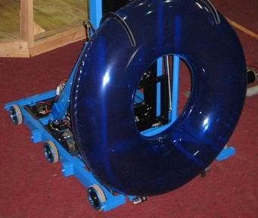
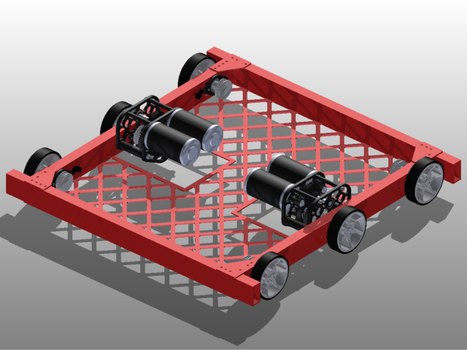
West Coast Drive
6WD or 8WD
Team 254 – Cheesy Poofs
Maximizes width of wheel base
  Wheels are over hung
  Axles have 2 bearings in a 1x2 box section
  Typically a cam chain/belt tensioning system
  More space inside
Light weight – uses bumpers as part of structure
Some integrate custom transmission with it
Usually requires higher precision machining
You don’t choose a WCD if you have not already developed a base design before the season
Some advantages but not necessarily optimum

Slide 15
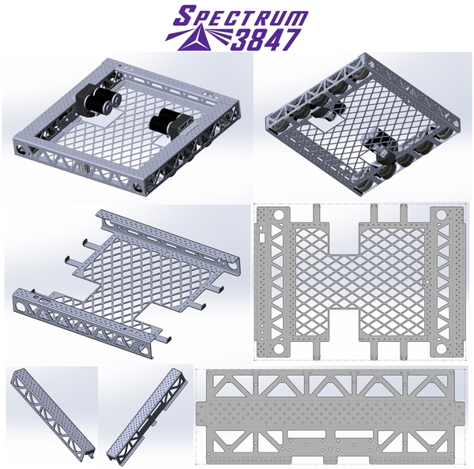
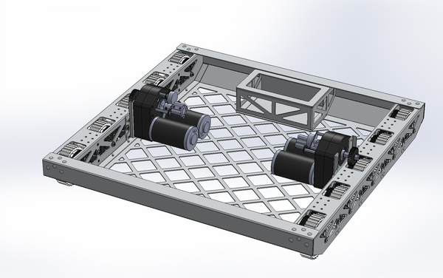
Sheet Metal Chassis
& All gear drive
Requires close relationship with Sheet Metal shop
  Water-jet
  Bending
  High precision
Strong CAD
Team 488

Slide 16
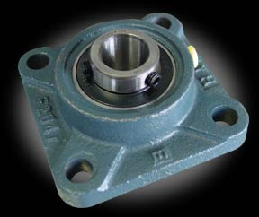
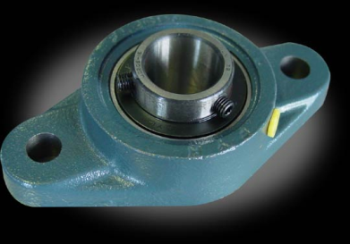
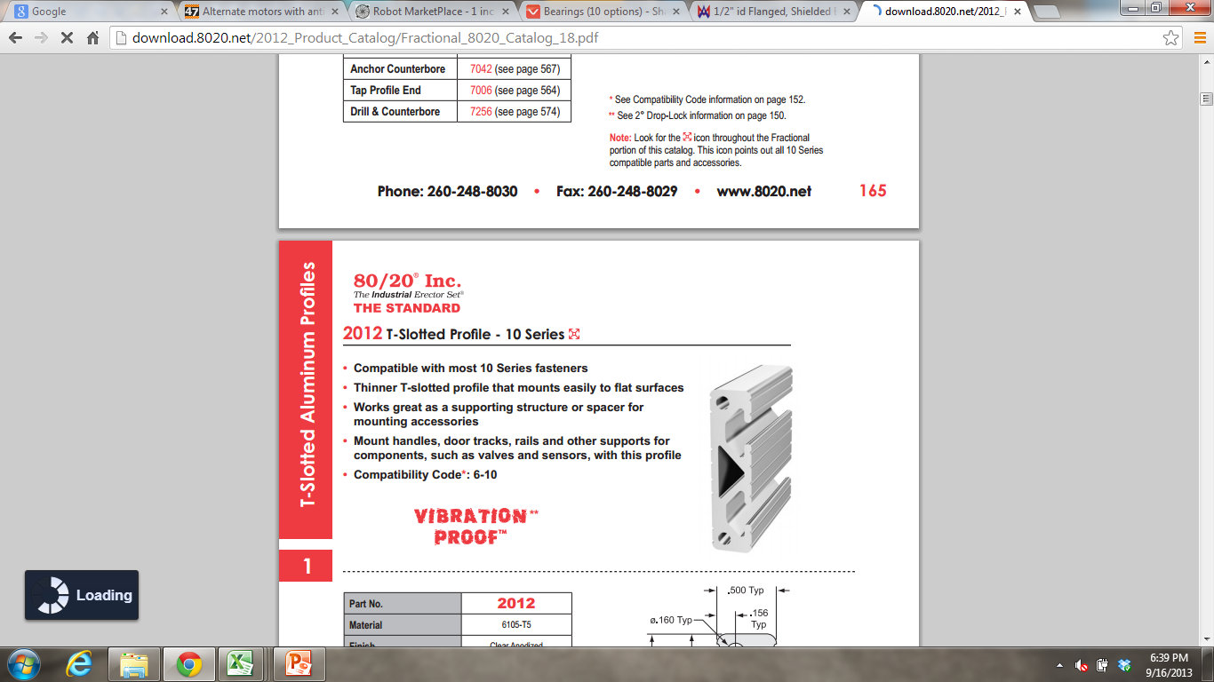
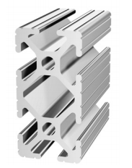
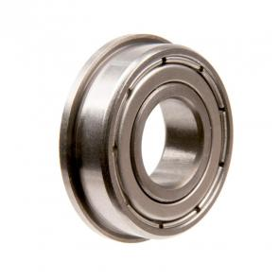
Bearing Blocks
How to Conveniently Keep Belts/Chains Tensioned
How to conveniently be able to adjust tension and spacing of drive (or other) axles?
Or could be:
Using Ball bearing – AM or VexPro
  Different shaft diameters and also Hex
    Hex bearings can be hard to get and/or unreliable
    Bearing is .25” thick + .0625” flange
Design a bearing block to hold bearing and fit 1020 T-slot hardware 80/20)?
    Desire bolt hole center distances to be 1”
      for use with 1020 t-slot
From Robot Marketplace
½” round shaft, cast Iron
1”
1.125” hole
with 1.25” counter-bore
5/16”
2012
1020
aluminum

Slide 17
New KOP Chassis – 2D “CAD”
Layout and Drive Train for the 2014 AM KOP chassis
Wide or Long option – convertible – also assuming 112” perimeter rule stays
  2 choices of aspect ratio? (likely – due to different belt lengths required)
Tough-box mini 10.7:1 gear ratio = ~ 10.5 fps – 2 CIMs/in gearbox – 6” wheels
  6 inch wheels: 4 wheel wheelbase = L = (full robot length – 7” )/2
Wheelbase width = robot width minus 4” - wheel ctr to wheel ctr
  31 x 25 robot => 4w wheelbase: 12” , width: 21 , W/L = 1.75 - Not too agile
  25 x 31 robot => 4w wheelbase: 9”, width = 27”, W/L = 3.0 - Hard to keep straight
Frame height above ground is ~ 2”– implies smooth surface for game?
L
Top View
½ Robot
6WD, belt drive
Wide or long
Assume 2 sets of belt lengths(?) for 2 out of the box set-ups
W/2

Slide 18
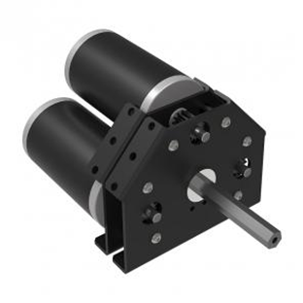
Upgrades on New KOP Chassis – 2D “CAD”
What can we improve on? Some Possibilities:
Optimize our own width to length
Change to 4” wheels, Swap out toughbox mini for:
  Vexpro 3 CIM 6:1 ratio gearbox 12.5 fps, + full torque
  Or 2 CIM with shifter gearbox (~14 & 5 fps)
  8WD or 6WD layouts possible
  Overall wheel base length is overall length – 5” (10% better than KOP)
Drop Frame to 1” height above carpet (lower c.g.)
8WD
6WD
Top View
½ Robot

Slide 19
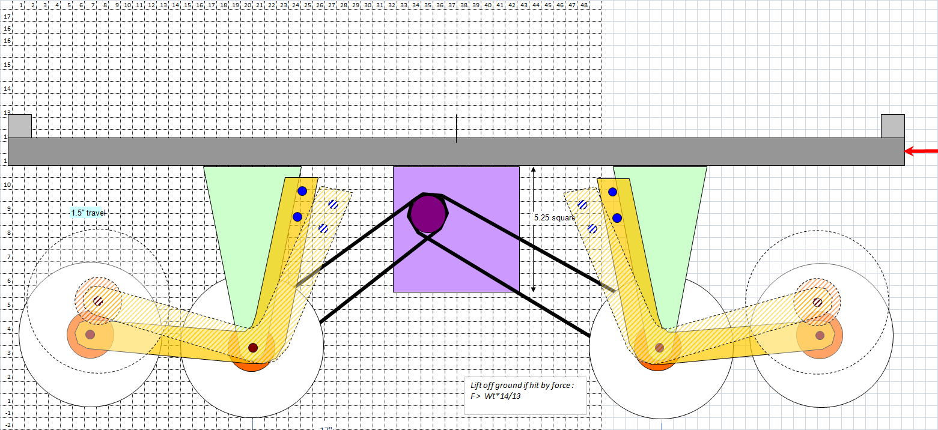
Ronaldo (2010 Robot) Drive Train
2D “CAD” example
Uses Excel – make grid squares to 20 pixels x 20 pixels
Use simple drawing functions to make simple 2D sketches
Easily email and communicate design ideas outside of meetings during build
Once 2D concept is worked out – can develop 3D Solidworks model
8 wheel drive system – front and back off of ground typically for ease of turning
Suspension mounted with springs – to absorb bumps better.
2 speed gearboxes

Slide 20
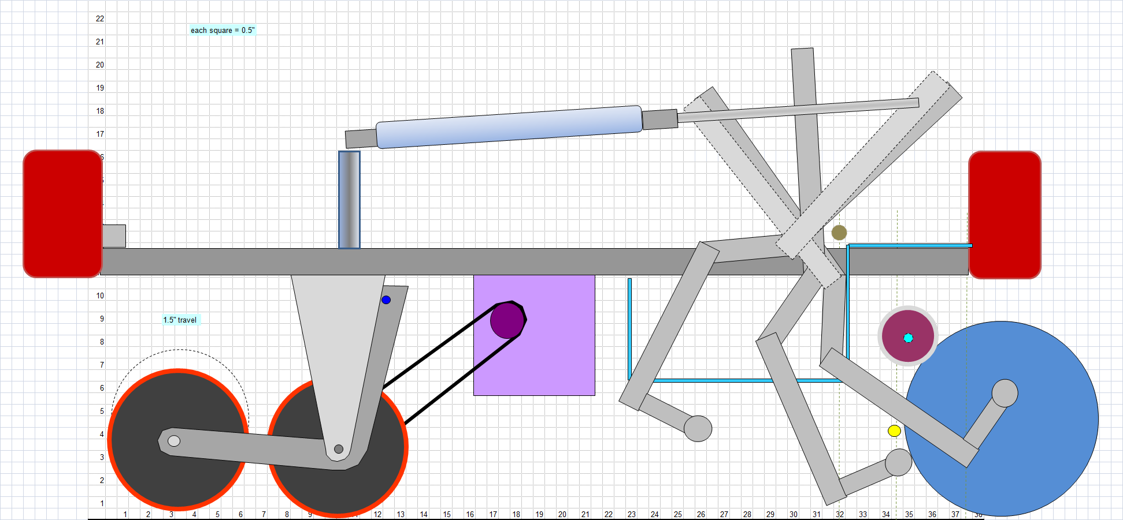
Ronaldo (2010 Robot) Roller/Kicker
Front wheels not displayed in this section view

Slide 21
Littlefoot: Early 2D rendering of CIMple gearboxes with chain drive system
4 independent motor/transmissions required for Meccanum drive.
Tank drive only requires 2 - allows for practical use of 2 speed transmissions.

Slide 22
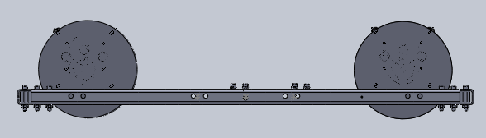
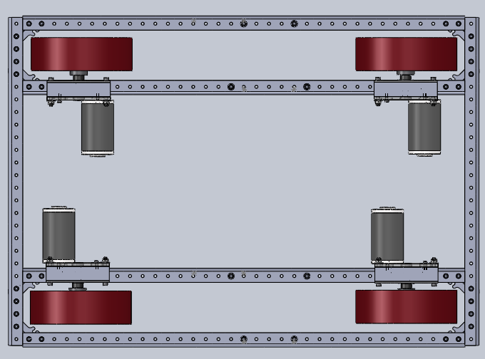
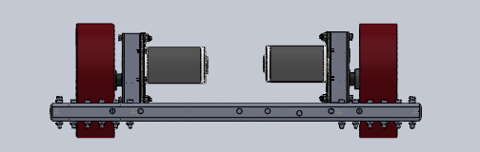
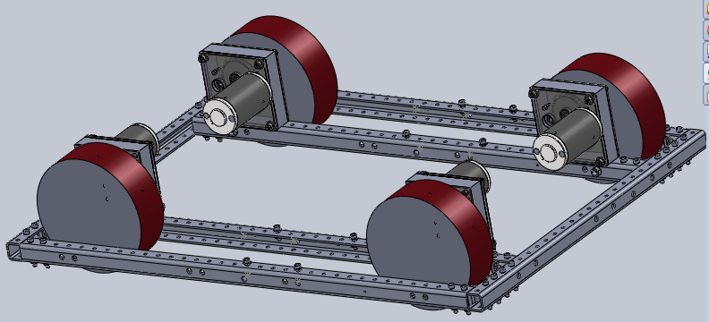
Side view:
Top view:
Motors would be symmetrical
(incorrect in model)
Front view:
Mecanum wheels being represented by cylinders with same envelope dimension
Direct Drive with Toughboxes
Would be modified with long shafts and straddle mount bearing – not modeled.

Slide 23
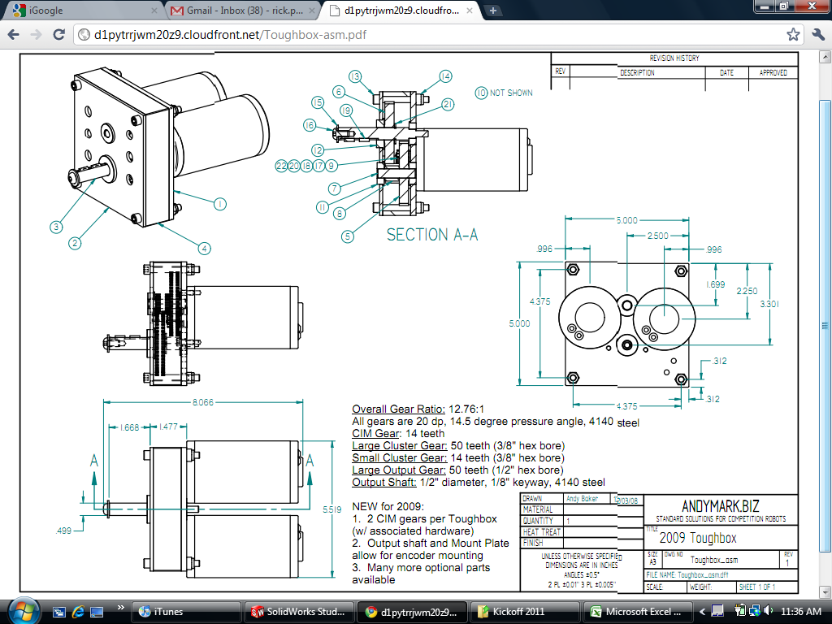

Slide 24
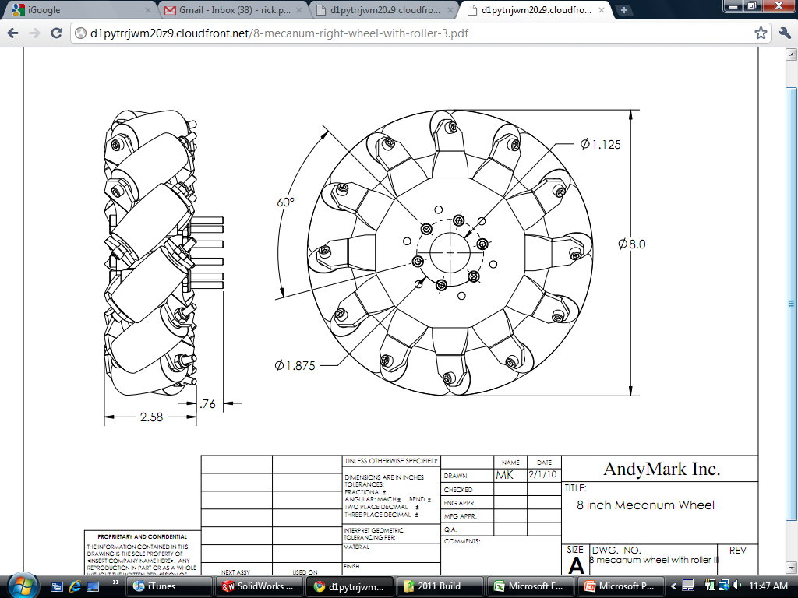

Slide 25
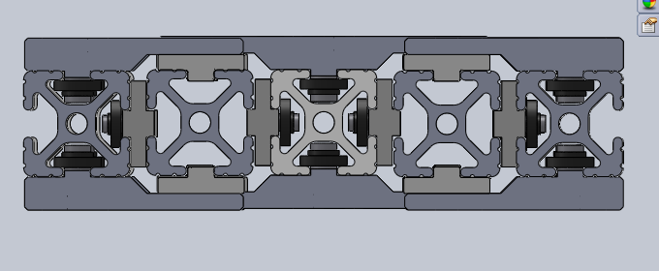
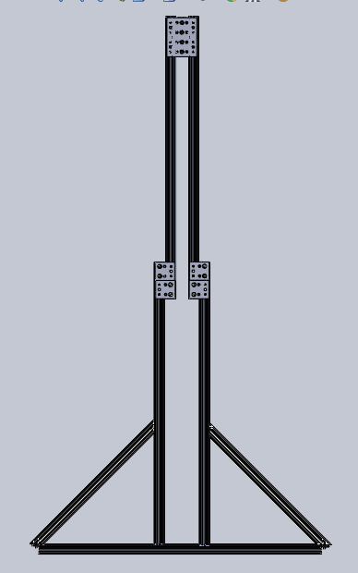
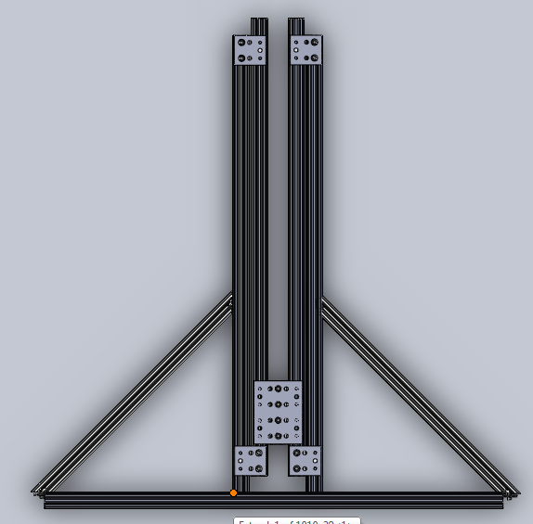
n

Slide 26
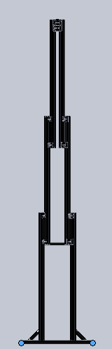
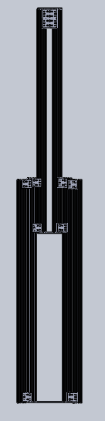
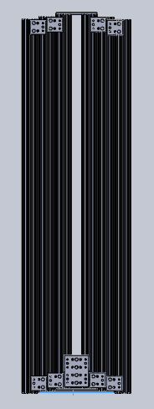
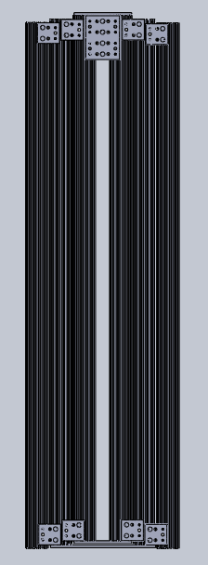
Based on work this afternoon -
Elevator slide CAD shown in 4 positions
Maintaining 12” overlap on 48” sections
Probably more height than needed – but may even allow tube to be held horizontally over top pegs.
The weight of what is modeled is about 25#.
Note the base shown on the right is the width of the robot….
122 inches
86 inches
50 inches
8 inches
27”

Slide 27
Based on work this afternoon -
Elevator slide CAD shown in 4 positions
Maintaining 12” overlap on 48” sections
Maybe more height than needed – but may even allow tube to be held horizontally over top pegs.
The weight of what is modeled is about 25#. Arm/claw not included
Note the base shown on the right is the width of the robot….
122 inches
86 inches
50 inches
8*48
+ 24
= 408”
= 34’
8 inches
27”

Slide 28
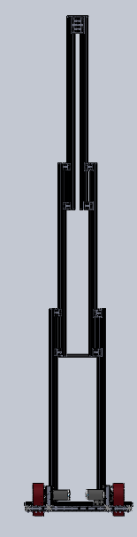
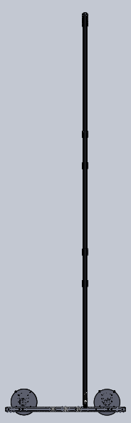
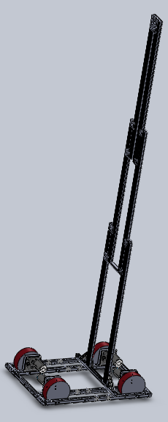
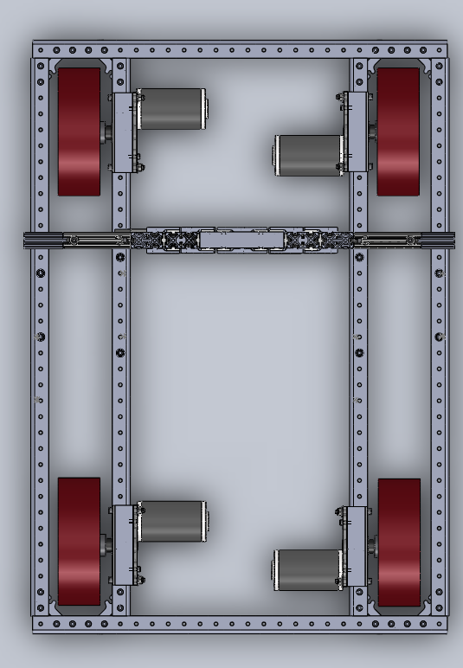
6 views with the robot base
Axial position of lift on robot is just approximate.
We better not drive with the lift up!

Slide 30
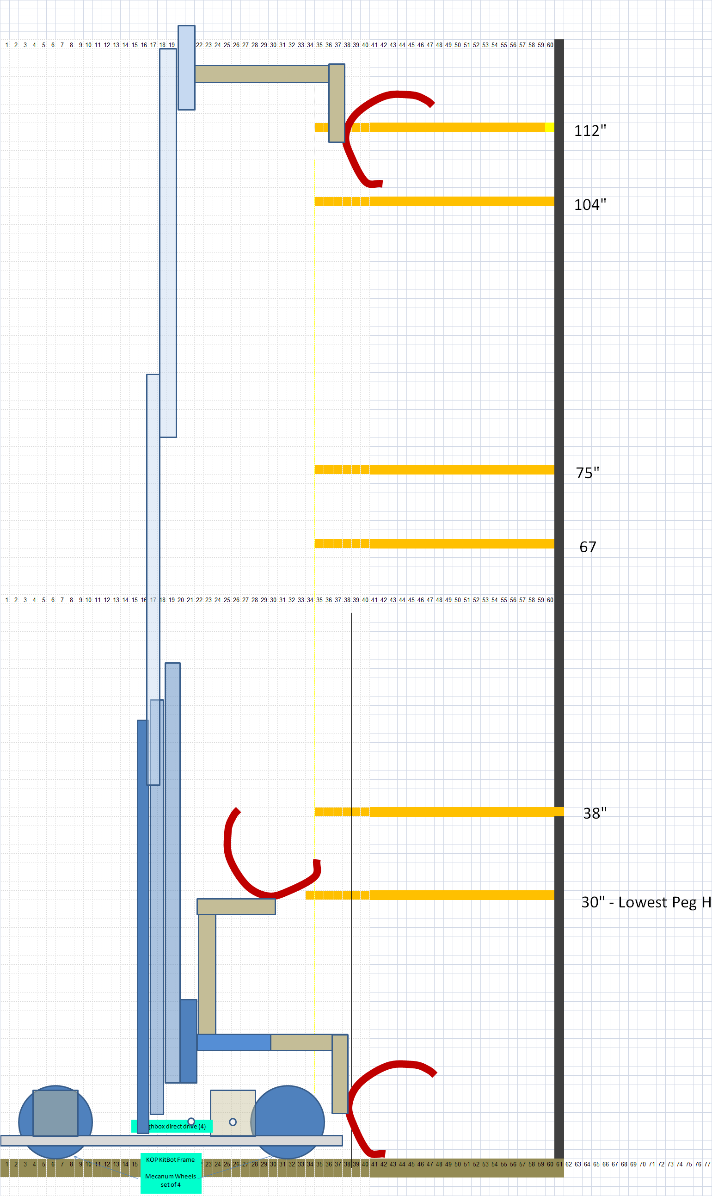
This layout – does not work!
Tube not placed on lowest – 30” peg
Can you fix it?
Figure out where is arm pivot – height and distance from frame/bumper
How many extensions , how long is each?
Bonus :
Design system with fixed height - no elevator - with telescoping or fixed arm
That can reach all pegs
a) What is fixed height of pivot?
b) What is arm config?
does it telescope?
claw type?

Slide 31
Simple Roller Claw Concept
Motor Name | Free Speed (RPM) | Stall Torque (N*m) | Stall Current (Amp) | Free Current (Amp) |  | Output RPM | Output RPS
CIM Motor (FR801-001) | 5310 | 2.43 | 133 | 2.7
Nippon-Denso Window Motor RH (262100-3030) | 84 | 10.6 | 18.6 | 1.8
Nippon-Denso Window Motor LH (262100-3040) | 84 | 10.6 | 21 | 1.8
FP 2011 (00801-0673) | 20770 | 0.5324 | 108.7 | 0.82 | 120:1 | 173.08 | 2.88
RS-775 (18V model @ 18V) | 19500 | 1.175 | 130 | 2.7
RS-775 (18V model @ 12V) | 13000 | 0.783333333 | 86.66666667 | 1.8 | 63:1 | 206.35 | 3.44
RS-550 | 19300 | 0.4862 | 85 | 1.4 | 63:1 | 306.35 | 5.11
RS-540 | 16800 | 0.2788 | 42 | 1 | 63:1 | 266.67 | 4.44
RS-395 | 15500 | 0.1176 | 15 | 0.5 | 63:1 | 246.03 | 4.10
10.5"

Slide 33
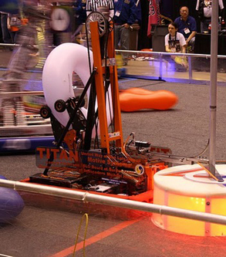
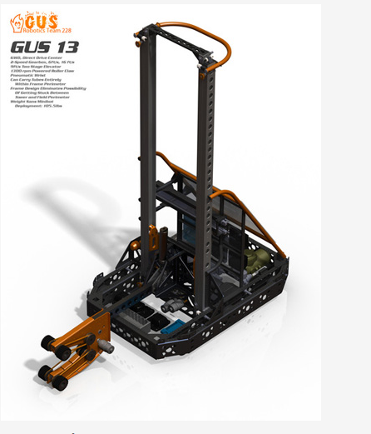
CAD can make Robot Designs that are cleaner, faster to build

Slide 34
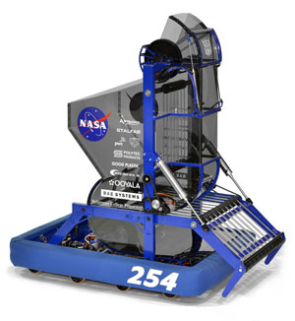
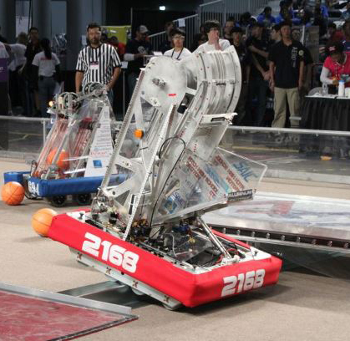
More CADded Robots

